Slide 1
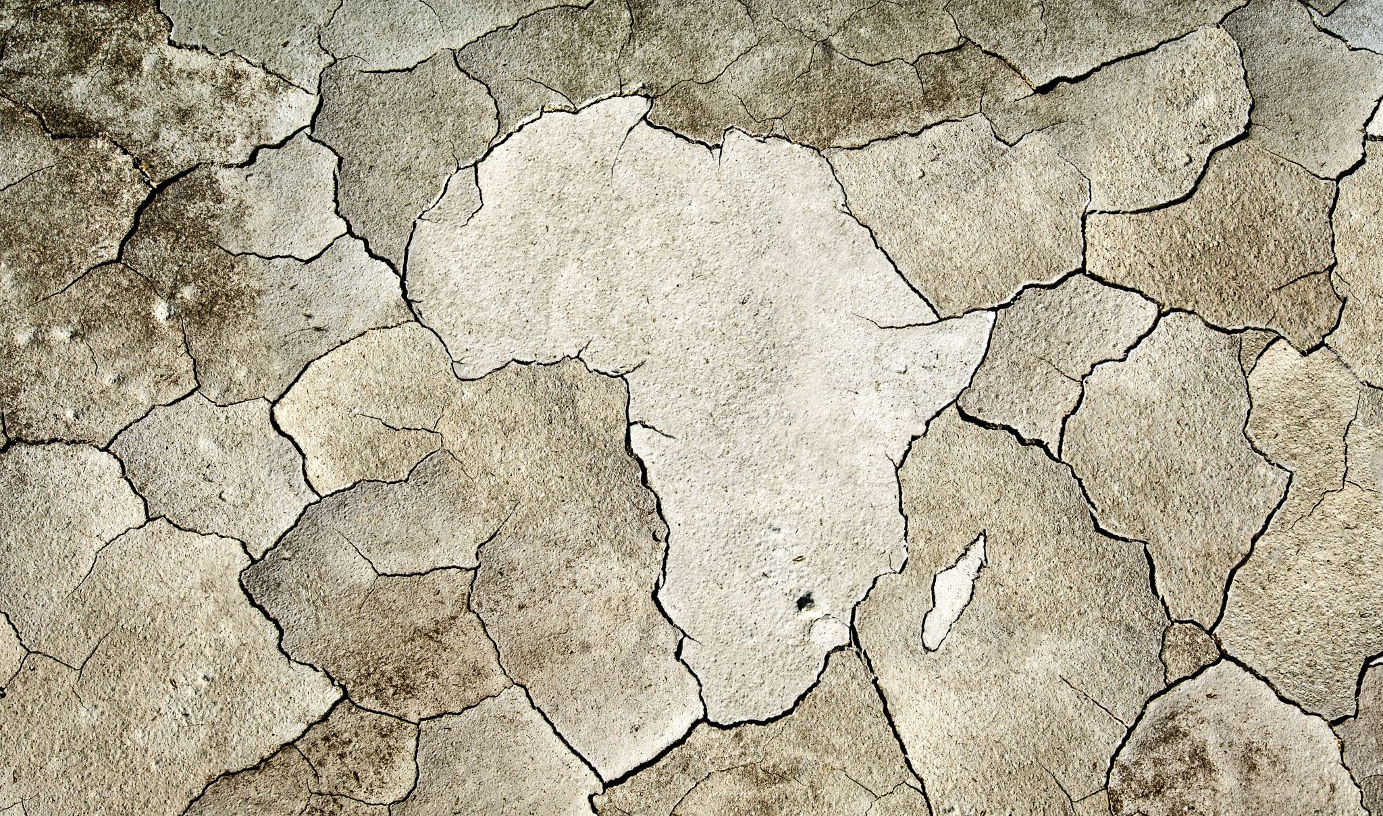
Excreta disposal

Slide 2
Methods of excreta disposal (unsewered areas)
SERVICE TYPE LATRINES (CONSERVANCY SYSTEM)
Nightsoil is collected from pail or bucket type of latrines by human agency, and later disposed of by buryinq or composting
NON-SERVICE TYPE (SANITARY LATRINES)
(a) Bore hole latrine
(b) Dug well or pit latrine
(c) Water-seal type of latrines
(i) RR.A.I. type
(ii) R.C.A. type
(iii) Sulabh Shauchalaya.
(d) Septic tank
(e) Aqua privy.
LATRINES SUITABLE FOR CAMPS AND TEMPORARY USE
(a) Shallow trench latrine
(b) Deep trench latrine
(c) Pit latrine
(d) Bore hole latrine

Slide 3
Methods of excreta disposal (sewered areas)
WATER-CARRIAGE SYSTEM AND SEWAGE TREATMENT
Primary treatment
Screening
Removal of grit
Plain sedimentation
Secondary treatment
Trickling filters
Activated sludge process
Other methods
Sea outfall
River outfall
Sewage farming
Oxidation ponds.

Slide 4
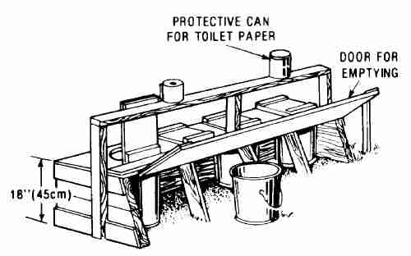
Service type (conservancy system)
The collection and removal of nightsoil from bucket or pail latrines by human agency and the latrines are called service latrines.
The nightsoil is transported in “nightsoil carts’ to the place of final disposal, where it is disposed off by composting or burial in shallow trenches.
The Environmental Hygiene Committee (1949) therefore, recommended that in unsewered areas the service latrines should be replaced by sanitary latrines which require no service, and in which excreta can be disposed off at the site of the latrine in a hygienic manner

Slide 5
Service type (conservancy system) - Pitfalls
Service latrines are a source of filth and insanitation.
They tend to perpetuate the disease cycle of faecal-borne diseases in the community.
The night soil is exposed to flies.
Possibility of water and soil pollution.
The buckets and pans are subject to corrosion and require frequent replacement.
The emptying operation of the buckets is not always satisfactory.
It is difficult to recruit adequate staff needed for the collection of nightsoil.
The employment of human labour for the collection of nightsoil is not consistent with human dignity and is no longer pardonable.

Slide 6
Sanitary Latrines
Criteria
Excreta should not contaminate the ground or surface water
Excreta should not pollute the soil
Excreta should not be accessible to flies, rodents, animals (pigs, dogs, cattle, etc.) and other vehicles of transmission.
Excreta should not create a nuisance due to odour or unsightly appearance.

Slide 7
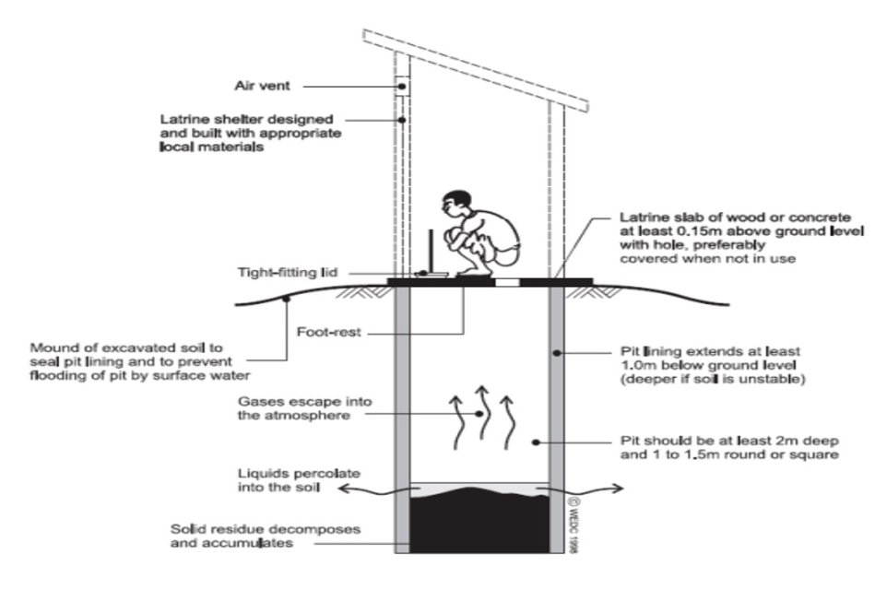
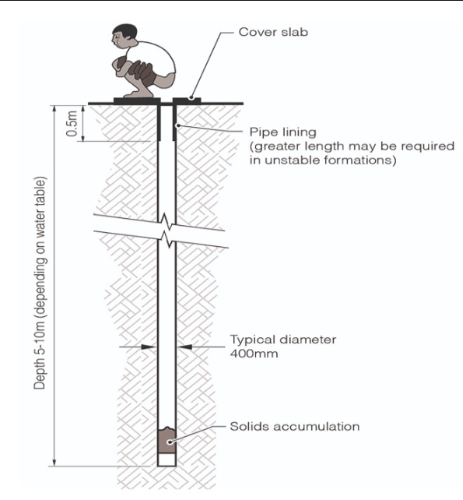
Sanitary latrines
Bore Hole Latrine
Dug Well Latrine or pit Latrine
30 – 40 cm (12 – 16”)
D = 75cm / 30”
4 – 8 m (13 – 26ft) [6m (20ft)
d= 3 – 3.5 m (10 – 12 ft)
Family of 5 or 6 people - over a year.
Sandy areas – d = 1.5 – 2 m (6 – 7 ft)
Sludge accumulates ~ 2.1 to 7.3 cubic feet per 1,000 users days
Family of 4 to 5 people – 5 years.

Slide 8
Sanitary latrines
Bore Hole Latrine
Dug Well Latrine or pit Latrine
Commonality
In loose and sandy soils, the hole is lined with bamboo matting or earthen-ware rings to prevent caving in of the soil.
A concrete squatting plate with a central opening and foot rests is placed over the hole & A suitable enclosure is put up to provide privacy.
The nightsoil undergoes purification by anaerobic digestion and is eventually converted into a harmless mass.
When the contents reach within 50 cm (20 in.) of the ground level, the squatting plate is removed and the hole is closed with earth. And a new hole is dug and similarly used.
If located 15 m (50 ft.) away from a source of water supply, there should be no danger of water pollution.

Slide 9
Sanitary latrines
Bore Hole Latrine
Dug Well Latrine or pit Latrine
First introduced by the Rockefeller foundation during 1930’s in campaigns of hookworm control.
Bore hole is essentially a family type of installation and is not recommended as a public convenience because of its small capacity.
Merits:
There is no need for the services of a sweeper for daily removal of nightsoil,
The pit is dark and unsuitable for fly breeding
Demerits
The bore hole fills up rapidly because of its small capacity
A special equipment, the auger, is required for its construction which may not be readily available
The subsoil water is high and the soil loose, with the result it may be difficult to dig a hole deeper than 3 m (10 ft.).
The bore hole latrine is therefore, not very much in use today. It has been superseded by better innovations.
First introduced in Singur, West Bengal in 1949-1950 (1).
It is an improvement over the bore hole latrine.
Merits
It is easy to construct and no special equipment such as an auger is needed to dig the pit
The pit has a longer life than the bore hole because of greater cubic capacity.

Slide 10
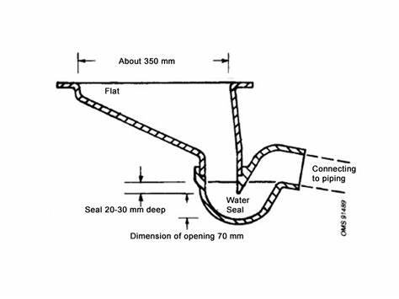
Water seal Latrine
Hand-flushed “water seal” type of latrine.
The squatting plate is fitted with a water seal.
Small depth of water contained in a bent pipe called the trap.
Two important functions :
It prevents access by flies.
It prevents escape of odours and foul gases
Once the latrine is flushed, nightsoil is no longer visible.
P.R.A.I. type, evolved by the Planning, Research and Action Institute, Lucknow (Uttar Pradesh)
RCA type, designed by the Research-cum-Action Projects in Environmental Sanitation of the Ministry of Health, Government of India.
Of these two types, the RCA latrine has been accepted as a suitable design for wide adoption in different parts of the country

Slide 11
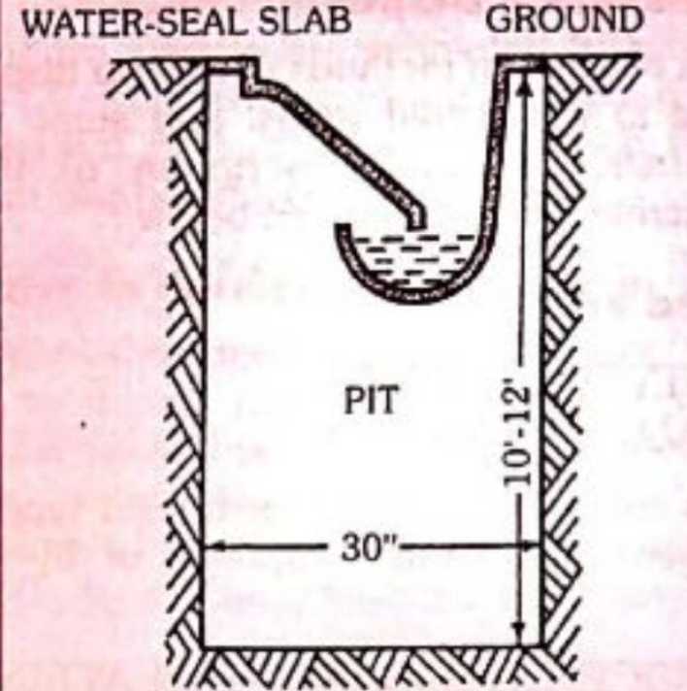
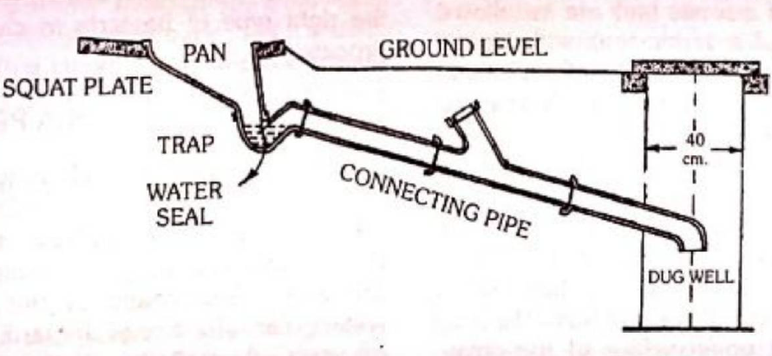
Direct / Indirect Water seal Latrine

Slide 12
Parts of RCA Latrine - Location
Depend upon the porosity of the soil, level of ground water, its slope and direction of flow.
Latrines of any kind should not be located within 15 m (50 ft) from a source of water supply,
Should be at a lower elevation to prevent the possibility of bacterial contamination of the water supply.
Latrines should not be located in areas usually subject to flooding.

Slide 13
Squatting plate
It should be made of an impervious material so that it can be washed and kept clean and dry.
If kept dry, it will not facilitate the survival of hookworm larvae,
In recommending squatting plates, due consideration should be paid to the habits of Indian people
It is made of cement concrete with minimum dimensions of 90 cm (3 ft) square and 5 cm (2 inch) thickness.
There is a slope 1/2 inch towards the pan which allows drainage
A circular squatting plate of 90 cm (3 ft.) diameter and of 5 cm (2 in ) uniform thickness also been found satisfactory.
Raised footrests are included in the squatting plate

Slide 14
Pan
The pan receives the nightsoil, urine and wash water.
The length of the pan is 42.5 cm (17 in.).
The width of the front portion of the pan has a minimum of 12.5 cm (5 in.) and the width at its widest portion is 20 cm (8 in.).
There is a uniform slope from front to back of the pan.
The pan is given a smooth finish.

Slide 15
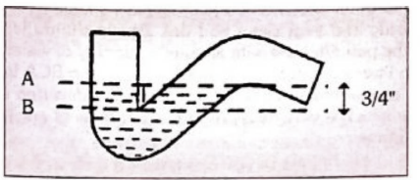
Trap
The trap is a bent pipe, about 7.5 cm (3 in.) in diameter and is connected with the pan.
It holds water and provides the necessary ‘water seal’.
The water seal is the distance between the level of water in the trap and the lowest point in the concave upper surface of the trap.
The depth of the water seal (AB) in the RCA latrine is 2 cm.

Slide 16
Connecting pipe
When the pit is dug, away from the squat plate, the trap is connected to the pit by a short length of connecting pipe 7.5 cm (3 in.) in diameter and at least 1 m (3 ft.) in length with a bend at the end.
A latrine of this type is called the Indirect type because the pit is sited away from the squatting plate.
In the direct type there is no need for a connecting pipe.
The direct type is best suited for areas where the ground is hard and does not easily cave in.
The direct type is cheaper and easier to construct and occupies less space.
An advantage with the indirect type is that when the pit fills up, a second pit can be put into operation by merely changing the direction of the connecting pipe.
The indirect type is usually preferred.

Slide 17
Dug well and superstructure
The dug well or pit is usually 75 cm (30 in.) in diameter, and 3 to 3.5 m (10-12 ft.) deep and is covered.
In loose soil and where the water table is high a lining of earthenware rings or bamboo matting can be used to prevent caving in of the pit fl).
SUPERSTRUCTURE
Provided for privacy and shelter.
An attractive superstructure with a neat finish is desirable as this will be generally well maintained.

Slide 18
Maintenance
The latrine should be used only for the purpose intended and not for disposal of refuse or other debris.
The squatting plate should be washed frequently and kept clean and dry.
People should learn to flush the pan after use with adequate quantity of water.
One to two litres of water are sufficient to flush the RCA latrine.
Proper maintenance involves health education of the people which is very necessary for the success of any latrine programme.

Slide 19
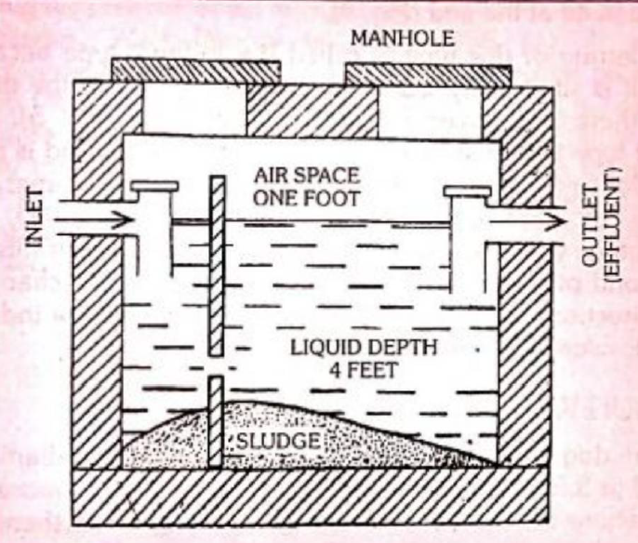
Septic tank
Water-tight masonry tank into which household sewage is admitted for treatment.
It is a satisfactory means of disposing excreta and liquid wastes from individual dwellings, small groups of houses and institutions which have adequate water supplies but do not have access to a public sewerage system.

Slide 20
Design
Double chambered and some single chambered.
A single chambered septic tank has been found satisfactory for small installations.
Tanks with more than two compartments are expensive and have shown little advantage over the two or multiple chambered septic tank.
Capacity
Depend upon the number of users.
A capacity of 20-30 gallons or 2.5-5 c.ft. per person is recommended for household septic tanks.
The minimum capacity of a septic tank should be at least 500 gallons.
Septic tanks are not recommended for large communities.

Slide 21
Design features
Length : The length is usually twice the breadth.
Depth : The depth of a septic tank is from 1.5 to 2 m (5-7 ft.).
Liquid depth : The recommended liquid depth is only 1.2 m (4 ft.).
Airspace : There should be a minimum air space of 30 cm (12 in.) between the level of liquid in the tank and the undersurface of the cover.
Bottom : In some septic tanks, the bottom is sloping towards the inlet end. This facilitates retention of solids.

Slide 22
Design features
Inlet and outlet: There is an inlet and outlet pipe, which are submerged.
Cover : The septic tank is covered by a concrete slab of suitable thickness and provided with a manhole.
Retention Period : Septic tanks are designed in this country to allow a retention period of 24 hours.
Too long a retention period will result in undue septicity of the effluent whereas too short a period gives insufficient treatment.

Slide 23
Working of septic tank
The solids settle down in the tank, to form “sludge”, while the lighter solids including grease and fat rise to the surface to form “scum”.
Anaerobic digestion
The solids are attacked by the anaerobic bacteria and fungi and are broken down into simpler chemical compounds.
The sludge is much reduced in volume as a result of anaerobic digestion, and is rendered stable and inoffensive.
A portion of the solids is transferred into liquids and gases (principally methane) which rises to the surface in the form of bubbles.
The liquid which passes out of the outlet pipe from time to time is called the “effluent”. It contains numerous bacteriae, cysts, helminthic ova and organic matter in solution or fine suspension.
Aerobic oxidation
The effluent is allowed to percolate into the sub-soil. It is dispersed by means of perforated or open-jointed pipes laid in trenches 90 cm (3 ft.) deep and the trenches are then covered with soil.
The effluent percolates into the surrounding soil. There are millions of aerobic bacteria in the upper layers of the soil, which attack the organic matter present in the effluent. As a result, the organic matter is oxidized into stable end products, i.e., nitrates, carbon dioxide and water.
These two stages complete the purification of sewage

Slide 24
Operation and maintenance
The use of soap water and disinfectants such as phenol should be avoided as they are injurious to the bacterial flora in the septic tank.
Undue accumulation of sludge reduces the capacity of the septic tank and interferes with proper working. Therefore, the contents of the septic tank should be bailed out at least once a year. This operation is called “desludging”.
The bailed out sludge is disposed of by trenching.
Newly built septic tanks are first filled with water up to the outlet level and then seeded with ripe sludge drawn from another septic tank, to provide the right type of bacteria to carry out the decomposition process.

Slide 25
Aqua Privy
The aqua privy functions like a septic tank and has been used in different regions in the country.
The privy consists of a water-tight chamber filled with water.
A short length of a drop pipe from the latrine floor dips into the water.
The size of the tank depends upon the number of users. A capacity of one cubic metre (35 cu.ft.) is recommended for a small family, allowing 6 years or more for cleansing purposes. Aqua privies are designed for public use also.
Night soil undergoes purification by anaerobic digestion Since there is evolution of gases, a vent should be provided for the escape of gases into the atmosphere, the vent should be open above the roof of dwellings.
The effluent is far from innocuous. It contains finely divided faecal matter in suspension and may carry parasitic and infective agents
It should be treated in the same manner as the effluent from a septic tank by sub-soil irrigation or absorption.
The digested sludge which accumulates in the tank should be removed at intervals.

Slide 26
Sulabh shauchalaya
Invention of a patna-based firm, is a low cost pour-flush, water-seal type of latrine, which is now being used in many parts of India.
It is an improved version of the standard handflush latrine (e.g., RCA type).
It consists of a specially designed pan and a water-seal trap.
It is connected to a pit 3 feet square and as deep.
Excreta undergoes bacterial decomposition and is converted to manure (compost).
The method requires very little water.
Sulabh International, the investors, not only build but also maintain the system of Sulabh Community Latrines.
Their usual structure is a lavatory block of several dozen seats, with a bathing block adjoining.
The system is to charge Rs. 5 per user.
Delhi has opted for this system in all its slums.
This system has drawn praise from ecologists and planners.

Slide 27
Chemical closet
It has very limited use under Indian conditions.
The closet consists of a metal tank containing a disinfectant fluid.
The active ingredients of the fluid are formaldehyde and Quaternary ammonium compounds.
In addition, a harmless water dye and a deodorizing substance are usually incorporated.
A seat with a cover is placed directly over the tank.
Nothing except the toilet paper should be thrown into the chemical closet.

Slide 28
Shallow trench latrine
This is simply a trench dug with ordinary tools. The
trench is 30 cm (1 ft.) wide and 90-150 cm (3-5 ft.) deep.
Its length depends on the number of users : 3-3.5 m (10 – 12 ft.) are necessary for 100 people.
Separate trenches should be provided for men and women.
The earth from trench should be piled up at the side.
People should be instructed to cover faeces with earth each time they use the Latrine.
Ablution water should be provided.
The shallow trench is a rudimentary arrangement for a short period (upto one week).
When the trench is filled to 30 cm (12 in.) below ground level, it must be covered with earth, heaped above ground level and compacted; if necessary, a new trench must be dug.

Slide 29
Deep trench latrine
This type of latrine is intended for camps of longer duration, from a few weeks to a few months.
The trench is 1.8 to 2.5 m (6-8 ft.) deep and 75-90 cm (30-35 in.) wide.
Depending upon the local customs, a seat or a squatting plate is provided. A superstructure is built for privacy and protection.

Slide 30
Water carriage system / sewerage system
Collecting and transporting of human excreta and waste water from residential, commercial and industrial areas, by a net-work of underground pipes, called sewers to the place of ultimate disposal.
It is the method of choice for collecting and transporting sewage from cities and towns where population density is high.
There are two types in water carriage system –
Combined system, the sewers carry both the sewage and surface water.
Separate system, surface water is not admitted into sewers.
It is considered the system of choice today.
Although the first sewers were laid in 1867 in Calcutta, the Mudaliar Committee (1962) reported that not more than 15 per cent of the urban population in India had the amenity of a sewerage system.
The problem is one of economics - a heavy outlay of capital is needed to install a water-carriage system.
Since water is needed for flushing the toilets and for conveying the human wastes, there can be no sewerage system without a piped water supply.

Slide 31
Elements
Household sanitary fittings (plumbing system of buildings)
House sewers
Street sewers or trunk sewers
Sewer appurtenances : manholes, traps, etc.

Slide 32
Household sanitary fittings
The usual household sanitary fittings are : (i) water closet, (ii) urinal and (iii) wash basin.
WATER CLOSETS may be broadly divided into two types : Indian squatting type and the Western commode type.
The water seal area should not be more than 7.5 cm.
There should not be any sharp corners in the trap design
The volume of water in trap should be as little as possible, preferably not exceeding 1.75 litres to maintain a minimum of 50 mm deep water seal.
The interior of the bowl should be vertical at least 50 to 75 mm just above the surface of water seal.
The water closets are provided with a ‘flushing rim’.

Slide 33
Household sanitary fittings
Human excreta is directly received into the water in the closet without soiling the sides.
The flushing removes all traces of excreta from the sides and keeps the closet clean.
The closet is connected to a small cistern by a pipe 2.5 to 3.75 cm (1-1.5 in.) in diameter.
The flushing cistern normally holds 15 litres (3 gallons) of water and works by syphonic action.
The flushing cisterns can be classified as high level, low level and integrated depending upon the height of location above the water closet bowl or pan.
The Indian squatting type W.C. pans are used with a high level flushing cisterns.

Slide 34
House drain
The house drain is usually 10 cm (4 in.) in diameter and is laid in the courtyard about 15 cm (6 in.) below the ground level on a bed of cement concrete with sufficient gradient towards the main drain.
The house drain empties the sewage into the main sewer or public drain.
Public sewer
The trunk sewers are not less than 22.5 cm (9 in.) in diameter; bigger ones may be 2 to 3 m (8-10 ft.) in diameter.
They are laid on a bed of cement concrete, about 3 m (10 ft.) below the ground level, with sufficient gradient to ensure what is known as “self-cleansing” velocity; this varies from 2 to 3 feet per second.
The trunk sewers collect sewage from several houses and transport to the main outfall or place of final disposal.

Slide 35
Sewer appurtenances
These are (a) manholes and (b) traps.
MANHOLES are openings built into the sewerage system.
Whenever there is a change in the direction of sewers
At the meeting point of two or more sewers,
At distances of 100 metres in long straight runs.
These openings permit a man to enter the sewer for inspection, repairs and cleaning.
Workers entering the manholes are liable to gas poisoning and asphyxiation.
TRAPS are of various kinds, these are devices designed to prevent foul gases entering the houses and to remove sand, grit and grease from sewage.
Under the basin of water closets,
Where the house drain joins the public drain (intercepting trap),
Where surface waste water enters the drains.
Sewer systems are designed, like water supplies, for service for one generation (30 years).

Slide 36
Sewage
Sewage is waste water from a community, containing solid and liquid excreta, derived from houses, street and yard washings, factories and industries.
It resembles dirty water with an unpleasant smell.
The term “sullage” is applied to waste water which does not contain human excreta, e.g., waste water from kitchens and bathrooms.
The amount of sewage that flows in the sewers depends upon :
Habits of the people : If people use more water, there will be more sewage
Time of day : Sewage does not flow uniformly throughout the day.
It is subject to variations depending upon the time of day and during different seasons.
In the morning, when people tend to use more water there is greater quantity and flow: in mid-day the flow is less, and again there is a slight increase in the evening.
The average amount of sewage which flows through the sewerage system in 24 hours is called the “dry weather flow.”

Slide 37
Health aspects
Creation of nuisance, unsightliness and unpleasant odours.
Breeding of flies and mosquitoes
Pollution of soil and water supplies
Contamination of food, and
Increase in the incidence of disease, especially enteric and helminthic diseases.

Slide 38
Composition of sewage
Sewage contains 99.9 per cent of water.
The solids which comprise barely 0.1 per cent are partly organic and partly inorganic; they are partly in suspension and partly in solution.
The offensive nature of the sewage is mainly due to the organic matter which it contains.
The organic matter decomposes according to the laws of nature during which process it gives off offensive odours.
In addition, sewage is charged with numerous living organisms derived from faeces, some of which may be agents to disease. It is estimated that one gram of faeces may contain about 1,000 million of E. coli, 10 to 100 million of faecal streptococci, and 1 to 10 million spores of Cl. Perfringens besides several others.
The average adult person excretes daily some 100 grams of faeces.

Slide 39

Thank you

